Slide 1

CS101 Data Structures
Binary Search Trees
Textbook Ch 12
Notes:
Adapted from the slides by Douglas Wilhelm Harder of U Waterloo (https://ece.uwaterloo.ca/~dwharder/aads/Lecture_materials/)
May also contain material from the slides at https://courses.cs.washington.edu/courses/cse326/03wi/326lecturesb.shtml (by Dan Suciu of U Washington)

Slide 2
Outline
Sorted list ADT
Binary search tree
Definition
Implementation
AVL tree
Red-black tree
More.
Notes:
Abstract Data Type Sorted List

Slide 3
Outline
This topic covers binary search trees:
Abstract Sorted Lists
Background
Definition and examples
Implementation:
Front, back, insert, erase
Previous smaller and next larger objects
Finding the k^{th} object

Slide 4
Sorted List ADT
Previously, we discussed Abstract Lists
the objects are explicitly ordered by the programmer
We will now discuss the Abstract Sorted List:
the objects are ordered by their values
Certain operations no longer make sense:
push_front and push_back are replaced by a generic insert

Slide 5
Sorted List ADT
Queries that can be made about data in a Sorted List ADT include:
Finding the smallest and largest entries
Finding the k^{th} largest entry
Find the next larger and previous smaller objects of a given object which may or may not be in the container
Iterate through those objects that fall on an interval [a, b]

Slide 6
Implementation
If we implement an Abstract Sorted List using an array or a linked list, we will have operations which are O(n)
As an insertion could occur anywhere in a linked list or array, we must either traverse or copy, on average, O(n) objects

Slide 7
Binary Search Trees
In a binary search tree, we require that
all objects in the left sub-tree to be less than the object stored in the root node
all objects in the right sub-tree to be greater than the object in the root object
the two sub-trees are themselves binary search trees

Slide 8
Definition
Thus, we define a non-empty binary search tree as a binary tree with the following properties:
The left sub-tree (if any) is a binary search tree and all elements are less than the root element, and
The right sub-tree (if any) is a binary search tree and all elements are greater than the root element

Slide 9
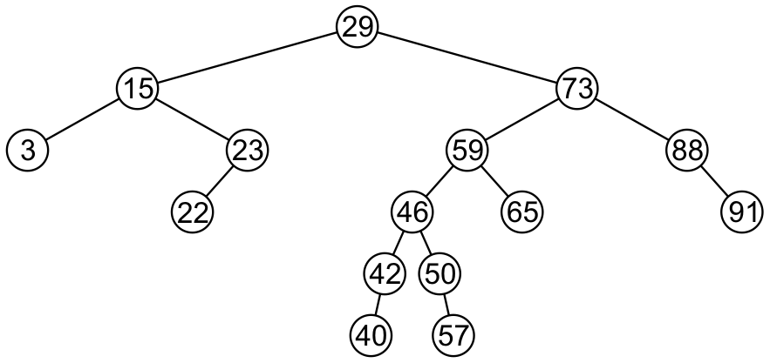
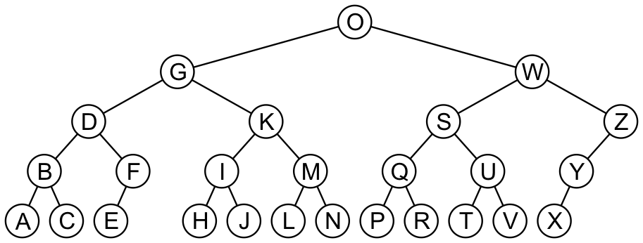
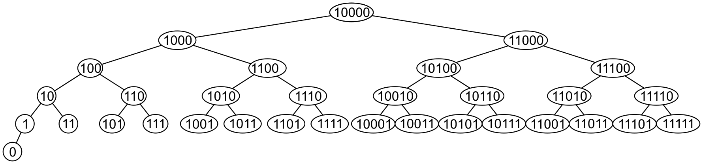
Examples

Slide 10
Search
To search an object: examine the root node and if we have not found what we are looking for:
If the object is less than what is stored in the root node, continue searching in the left sub-tree
Otherwise, continue searching the right sub-tree
Time complexity:
O(h)

Slide 11
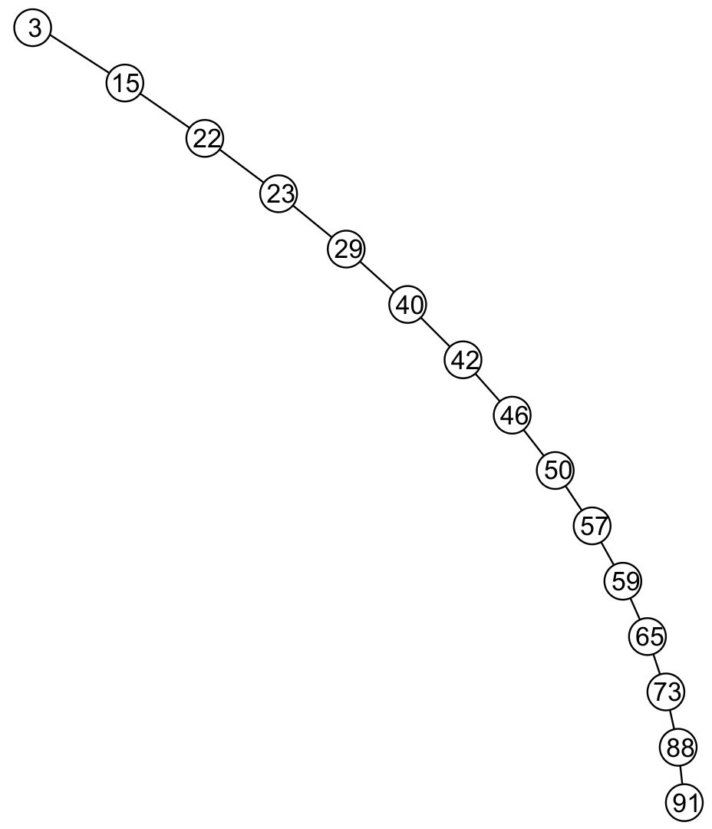
Worst case
Unfortunately, it is possible to construct degenerate binary search trees
This is equivalent to a linked list, i.e., O(n)

Slide 12
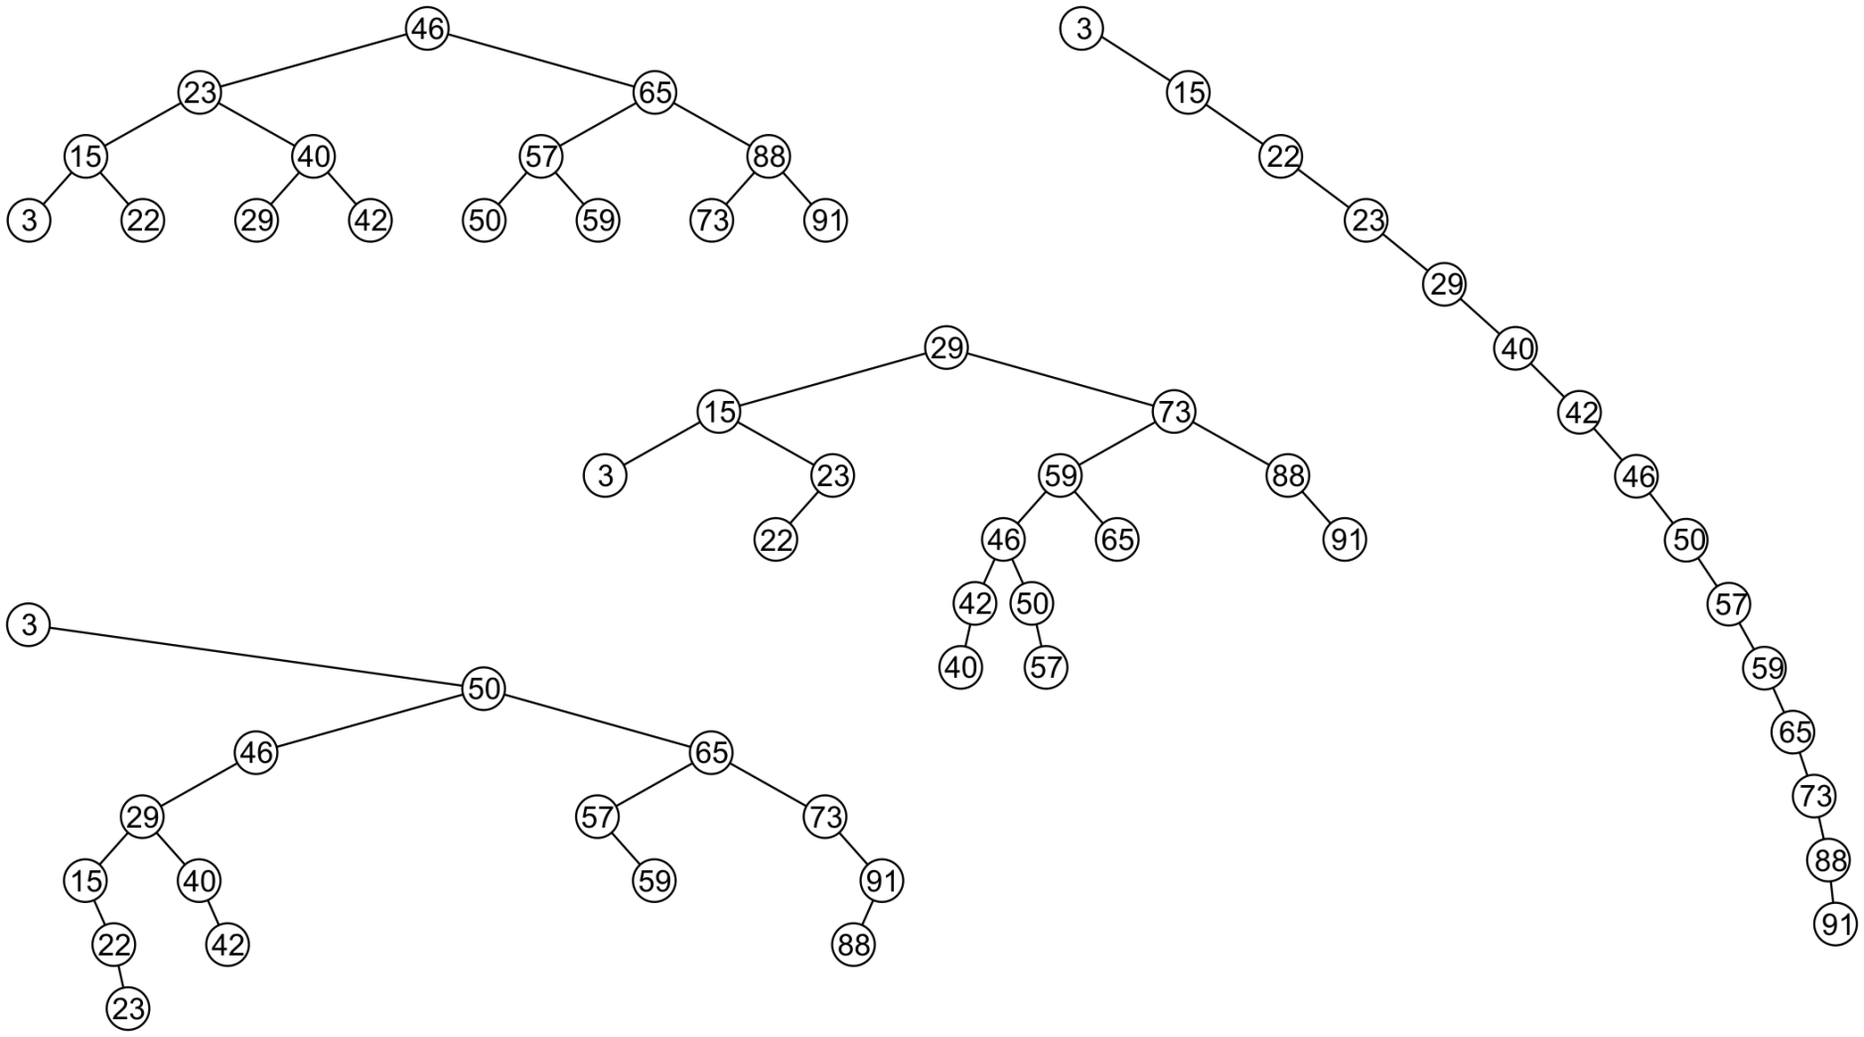
Examples
All these binary search trees store the same data

Slide 13
Duplicate Elements
We will assume that in any binary tree, we are not storing duplicate elements unless otherwise stated
In reality, it is seldom the case where duplicate elements in a container must be stored as separate entities
You can always consider duplicate elements with modifications to the algorithms we will cover

Slide 14
Implementation
We will look at an implementation of a binary search tree in the same spirit as we did with our Single_list class
We will have a Binary_search_nodes class
A Binary_search_tree class will store a pointer to the root
We will use templates, however, we will require that the class overrides the comparison operators

Slide 15
Implementation
Any class which uses this binary-search-tree class must therefore implement:
bool operator<=( Type const &, Type const & );
bool operator< ( Type const &, Type const & );
bool operator==( Type const &, Type const & );
That is, we are allowed to compare two instances of this class
Examples: int and double

Slide 16
Implementation
#include "Binary_node.h"
template <typename Type>
class Binary_search_node: public Binary_node<Type> {
using Binary_node<Type>::element;
using Binary_node<Type>::left_tree;
using Binary_node<Type>::right_tree;
public:
Binary_search_node( Type const & );
Binary_search_node *left() const;
Binary_search_node *right() const;
Notes:
template <typename Type>
class Binary_search_tree;

Slide 17
Implementation
Type front() const;
Type back() const;
bool find( Type const & ) const;
bool insert( Type const & );
bool erase( Type const &, Binary_search_node *& );
};
Notes:
void clear();
friend class Binary_search_tree<Type>;

Slide 18
Constructor
The constructor simply calls the constructor of the base class
Recall that it sets both left_tree and right_tree to nullptr
It assumes that this is a new leaf node
template <typename Type>
Binary_search_node<Type>::Binary_search_node( Type const &obj ):
Binary_node<Type>( obj ) {
// Just calls the constructor of the base class
}

Slide 19
Inherited Member Functions
The member functions
Type retrieve() const;
bool is_leaf() const
int size() const
int height() const
are inherited from the base class Binary_node

Slide 20
left(), right()
The base class returns a pointer to a Binary_node, we must recast them as Binary_search_node:
template <typename Type>
Binary_search_node<Type> *Binary_search_node<Type>::left() const {
return reinterpret_cast<Binary_search_node *>( Binary_node<Type>::left() );
}
template <typename Type>
Binary_search_node<Type> *Binary_search_node<Type>::right() const {
return reinterpret_cast<Binary_search_node *>( Binary_node<Type>::right() );
}

Slide 21
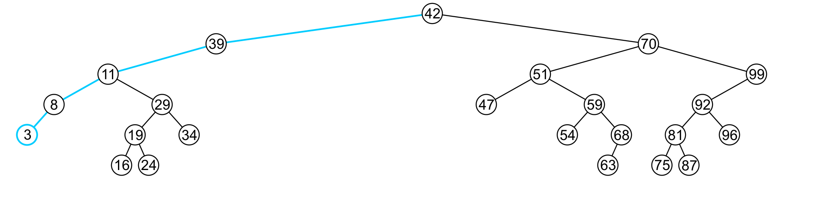
Finding the Minimum Object
template <typename Type>
Type Binary_search_node<Type>::front() const {
return ( left() == nullptr ) ? retrieve() : left()->front();
}
The run time O(h)

Slide 22
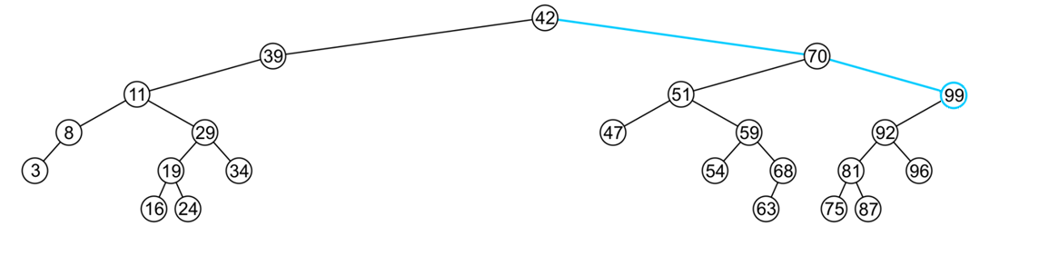
Finding the Maximum Object
template <typename Type>
Type Binary_search_node<Type>::back() const {
return ( right() == nullptr ) ? retrieve() : right()->back();
}
The extreme values are not necessarily leaf nodes
Notes:
22

Slide 23
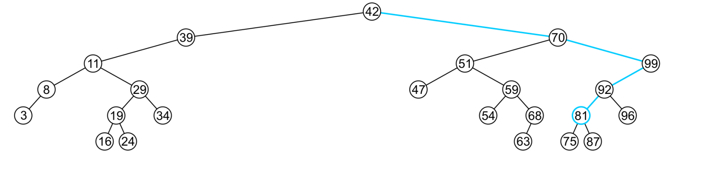
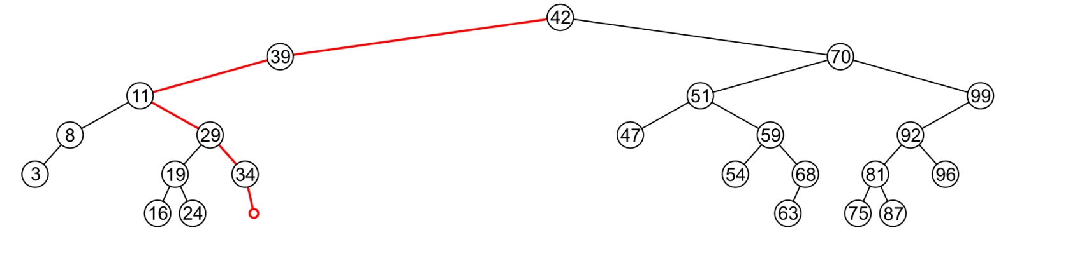
Find
To determine membership, traverse the tree based on the linear relationship:
If a node containing the value is found, e.g., 81, return true
If an empty node is reached, e.g., 36, the object is not in the tree:

Slide 24
Find
The implementation is similar to front and back:
template <typename Type>
bool Binary_search_node<Type>::find( Type const &obj ) const {
if ( retrieve() == obj ) {
return true;
}
if( obj < retrieve() )
return left()==nullptr? false : left()->find( obj );
else
return right()==nullptr? false : right()->find( obj );
}
The run time is O(h)
Notes:
24

Slide 25
Insert
Recall that a Sorted List is implicitly ordered
It does not make sense to have member functions such as push_front and push_back
Insertion will be performed by a single insert member function which places the object into the correct location

Slide 26
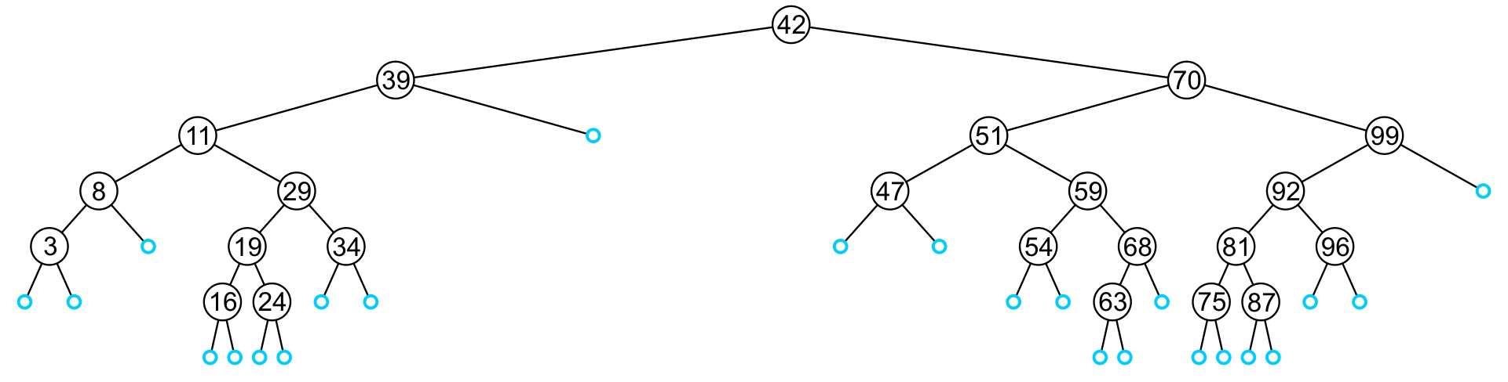
Insert
Any empty node is a possible location for an insertion
The values which may be inserted at any empty node depend on the surrounding nodes

Slide 27
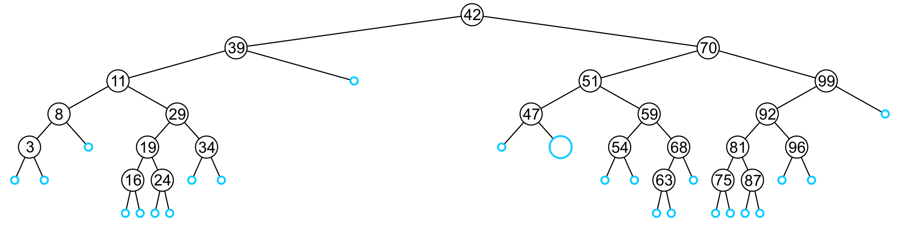
Insert
For example, this node may hold 48, 49, or 50

Slide 28
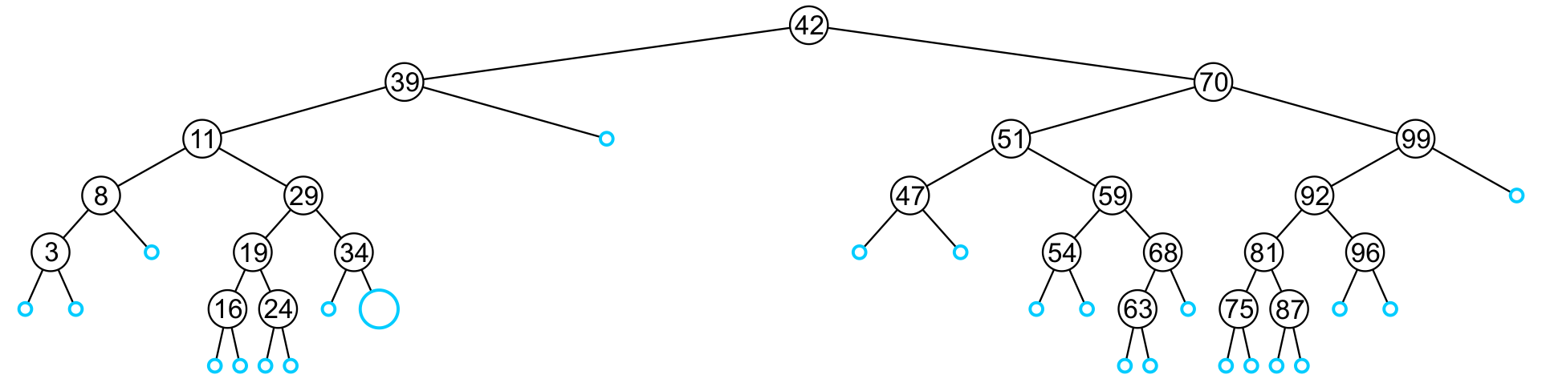
Insert
An insertion at this location must be 35, 36, 37, or 38

Slide 29
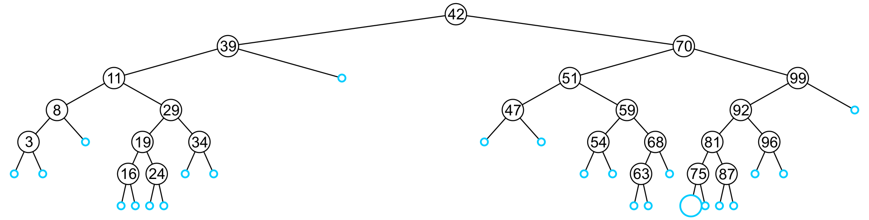
Insert
This empty node may hold values from 71 to 74

Slide 30
Insert
Like find, we will step through the tree
If we find the object already in the tree, we will return
The object is already in the binary search tree (no duplicates)
Otherwise, we will arrive at an empty node
The object will be inserted into that location
The run time is O(h)

Slide 31
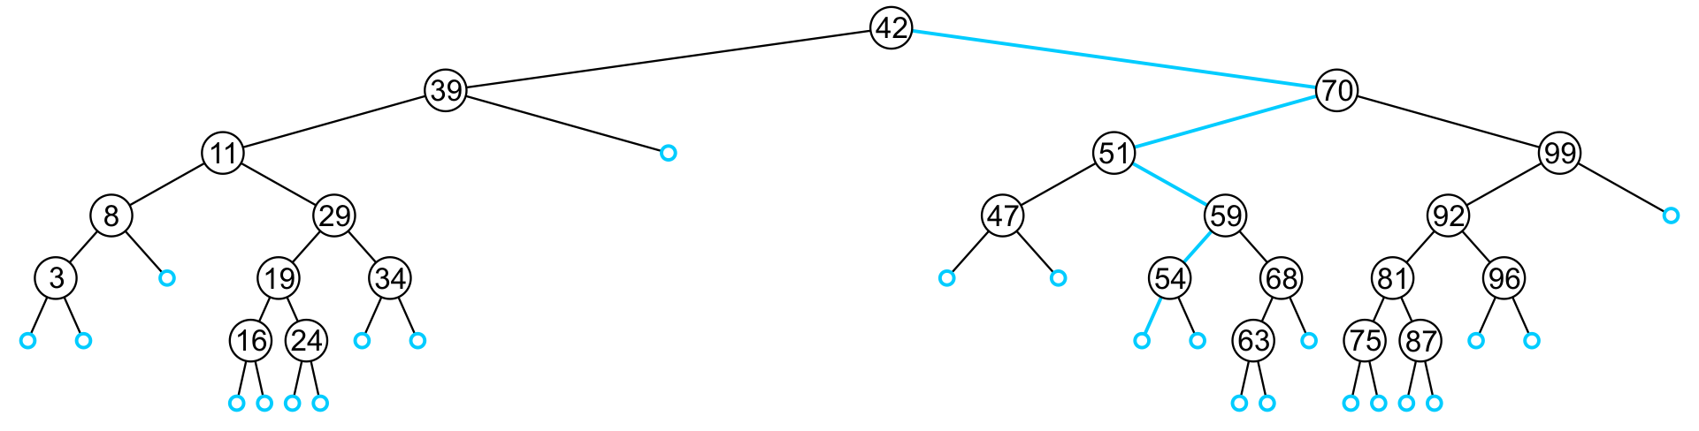
Insert
In inserting the value 52, we traverse the tree until we reach an empty node
The left sub-tree of 54 is an empty node

Slide 32
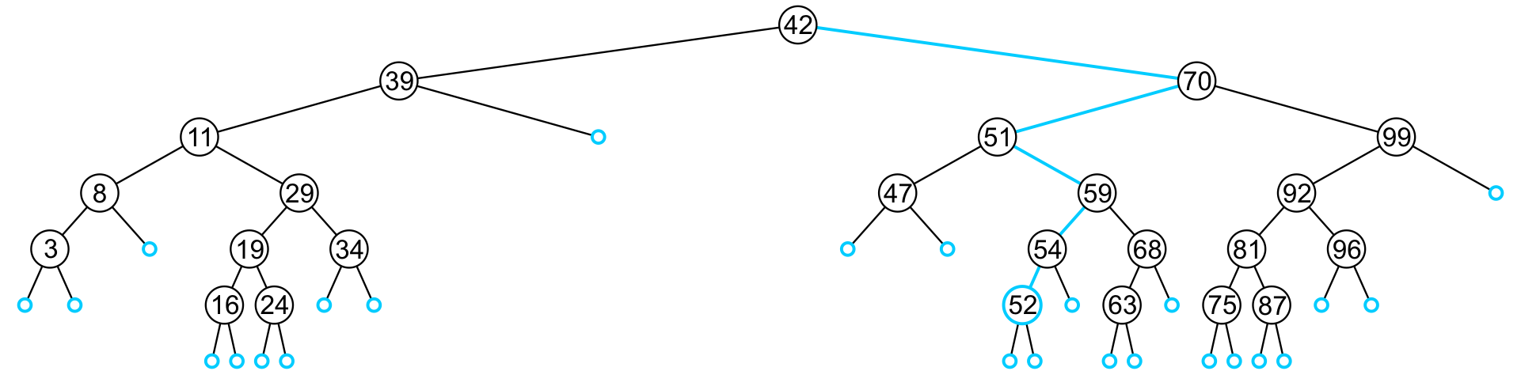
Insert
A new leaf node is created and assigned to the member variable left_tree

Slide 33
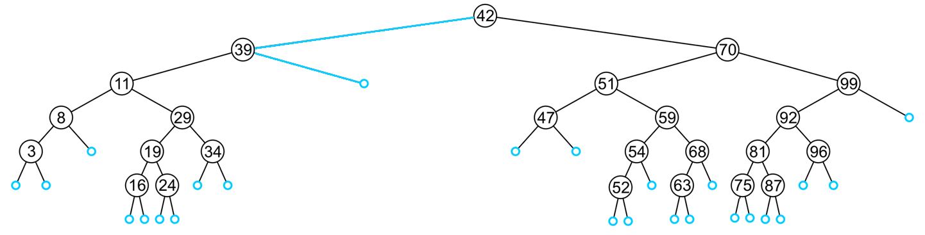
Insert
In inserting 40, we determine the right sub-tree of 39 is an empty node

Slide 34
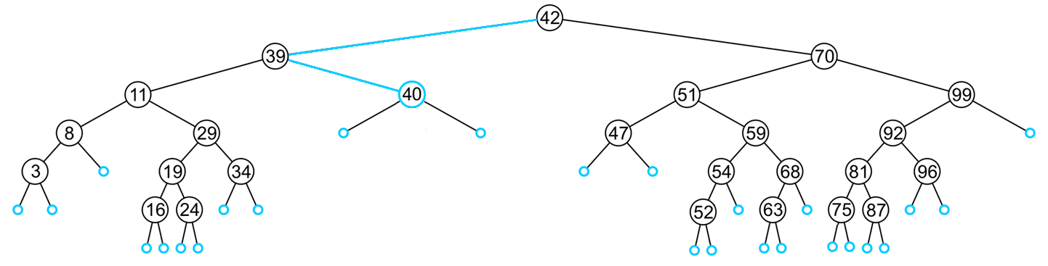
Insert
A new leaf node storing 40 is created and assigned to the member variable right_tree

Slide 35
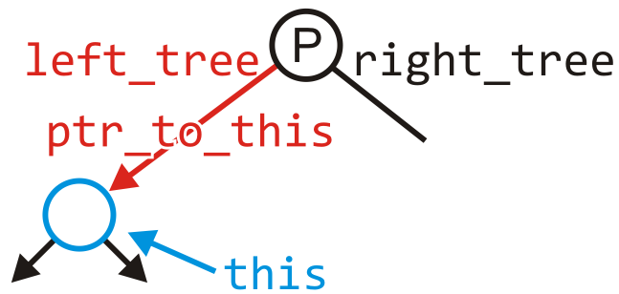
Insert
template <typename Type>
bool Binary_search_node<Type>::insert( Type const &obj,
Binary_search_node *&ptr_to_this ) {
if ( empty() ) {
ptr_to_this = new Binary_search_node<Type>( obj );
return true;
} else if ( obj < retrieve() ) {
return left()->insert( obj, left_tree );
} else if ( obj > retrieve() ) {
return right()->insert( obj, right_tree );
} else {
return false;
}
}

Slide 36
Insert
It is assumed that if neither of the conditions:
obj < retrieve()
obj > retrieve()
then obj == retrieve() and therefore we do nothing
The object is already in the binary search tree

Slide 37
Insert
Blackboard example:
In the given order, insert these objects into an initially empty binary search tree:
31 45 36 14 52 42 6 21 73 47 26 37 33 8
What values could be placed:
To the left of 21?
To the right of 26?
To the left of 47?
How would we determine if 40 is in this binary search tree?
Which values could be inserted to increase the height of the tree?

Slide 38
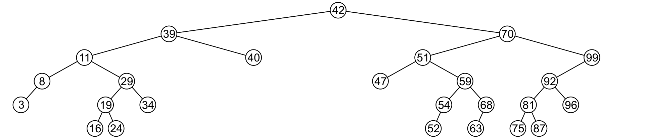
Erase
There are three possible scenarios:
The node is a leaf node,
It has exactly one child, or
It has two children (it is a full node)

Slide 39
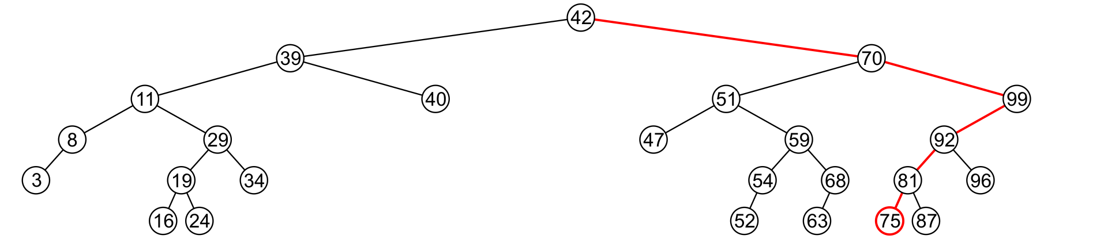
Erase
A leaf node simply must be removed and the appropriate member variable of the parent is set to nullptr
Consider removing 75

Slide 40
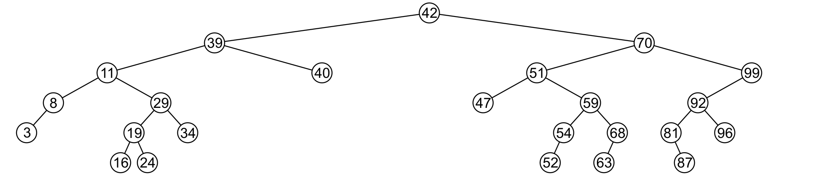
Erase
The node is deleted and left_tree of 81 is set to nullptr

Slide 41
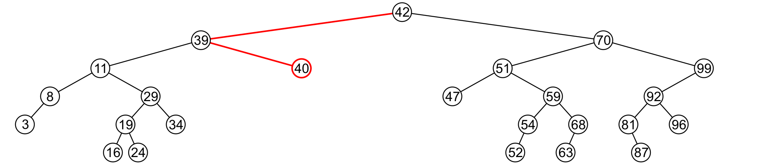
Erase
Erasing the node containing 40 is similar

Slide 42
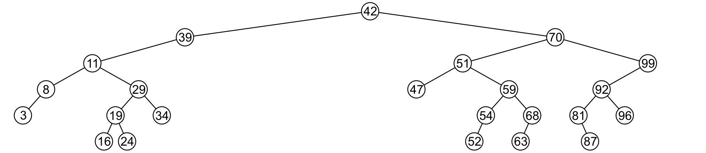
Erase
The node is deleted and right_tree of 39 is set to nullptr

Slide 43
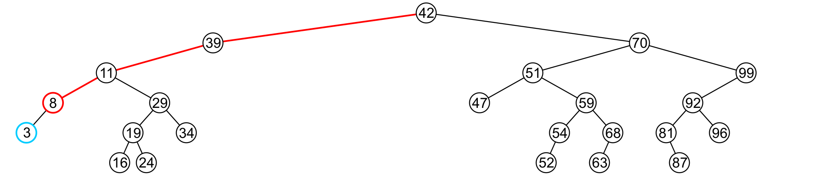
Erase
If a node has only one child…
we can simply promote the sub-tree associated with the child
Consider removing 8 which has one left child

Slide 44
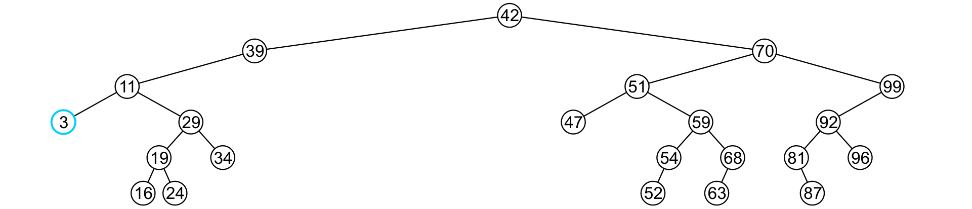
Erase
The node 8 is deleted and the left_tree of 11 is updated to point to 3

Slide 45
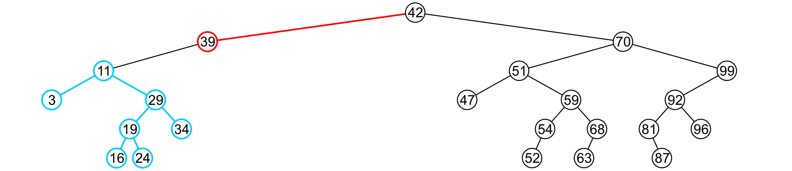
Erase
There is no difference in promoting a single node or a sub-tree
To remove 39, it has a single child 11

Slide 46
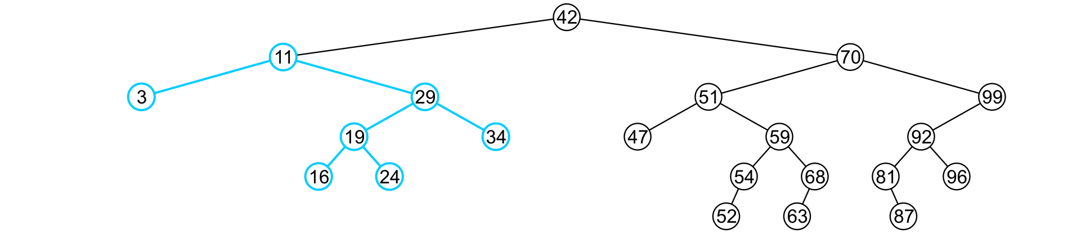
Erase
The node containing 39 is deleted and left_node of 42 is updated to point to 11
Notice that order is still maintained

Slide 47
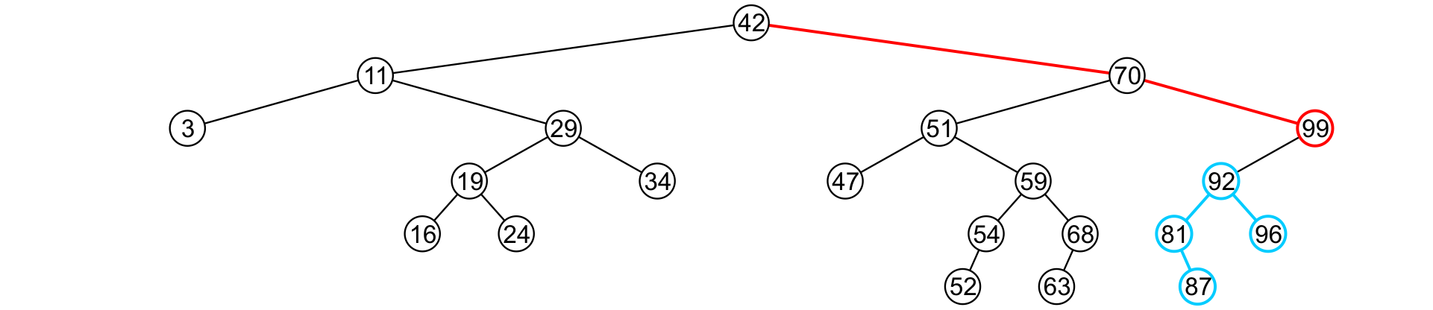
Erase
Consider erasing the node containing 99

Slide 48
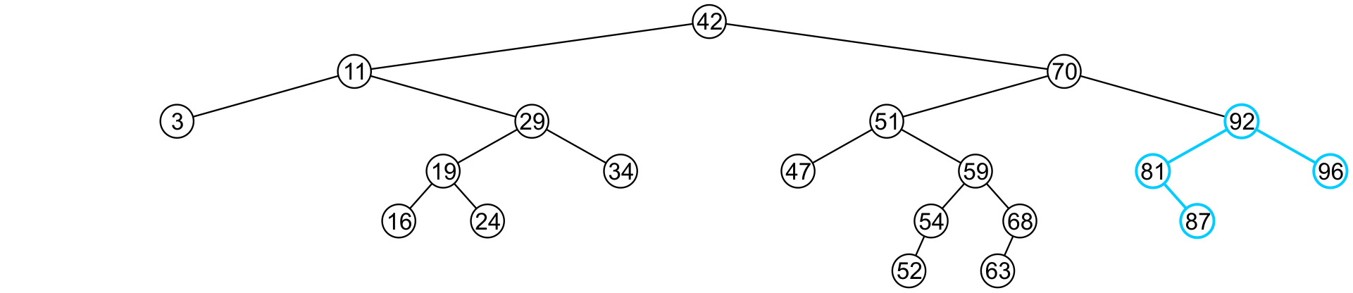
Erase
The node is deleted and the left sub-tree is promoted:
The member variable right_tree of 70 is set to point to 92
Again, the order of the tree is maintained

Slide 49
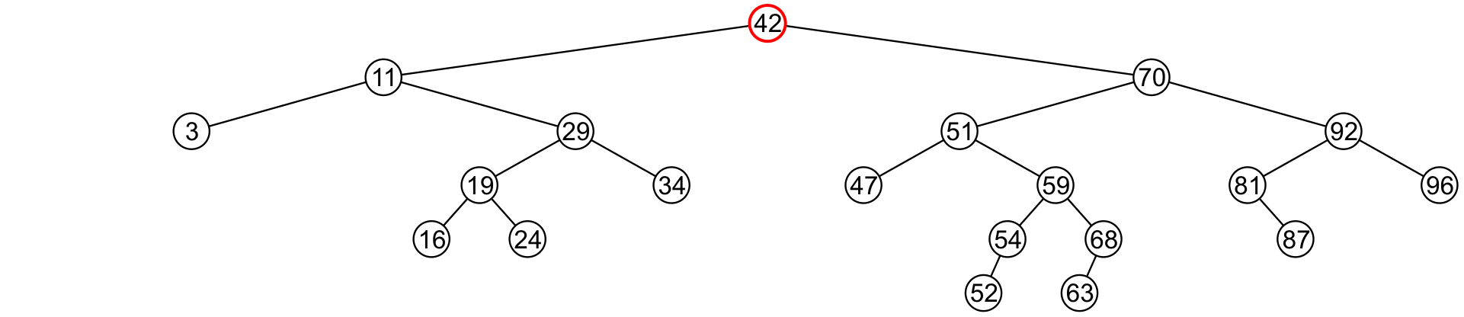
Erase
Finally, we will consider the problem of erasing a full node, e.g., 42
We will perform two operations:
Replace 42 with the minimum object in the right sub-tree
Erase that object from the right sub-tree

Slide 50
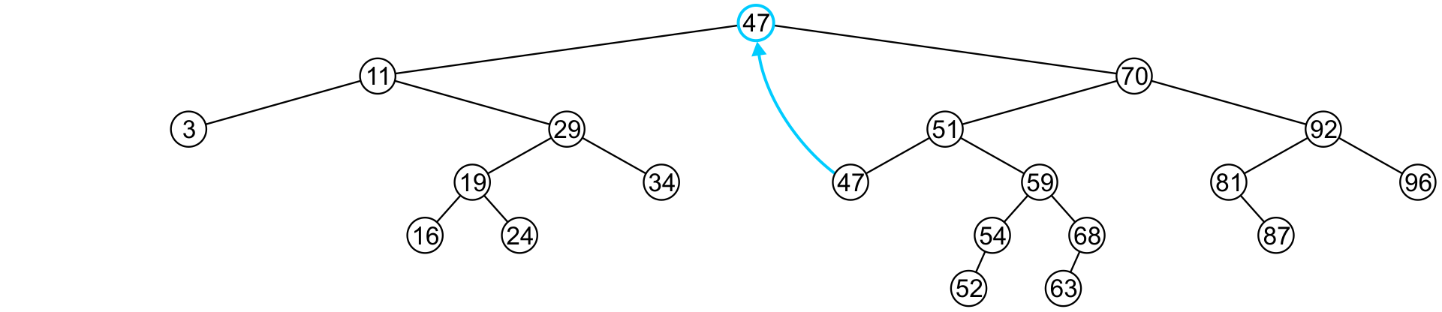
Erase
In this case, we replace 42 with 47
We temporarily have two copies of 47 in the tree

Slide 51
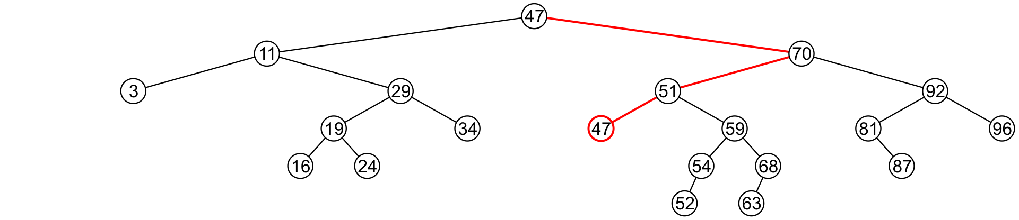
Erase
We now recursively erase 47 from the right sub-tree
We note that 47 is a leaf node in the right sub-tree

Slide 52
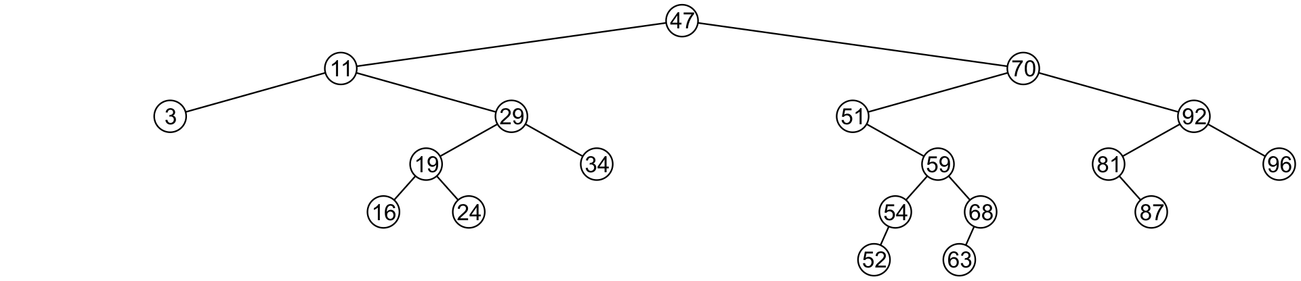
Erase
Leaf nodes are simply removed and left_tree of 51 is set to nullptr
Notice that the tree is still sorted:
47 was the least object in the right sub-tree

Slide 53
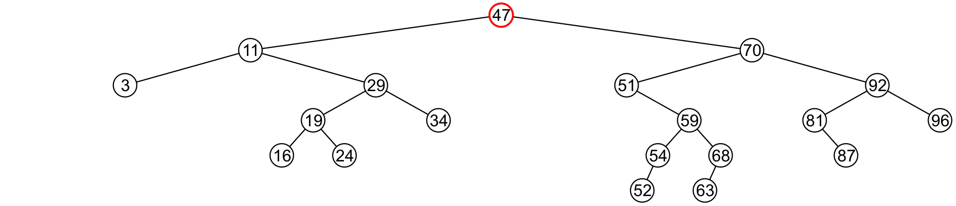
Erase
Suppose we want to erase the root 47 again:
We must copy the minimum of the right sub-tree
We could promote the maximum object in the left sub-tree and achieve similar results

Slide 54
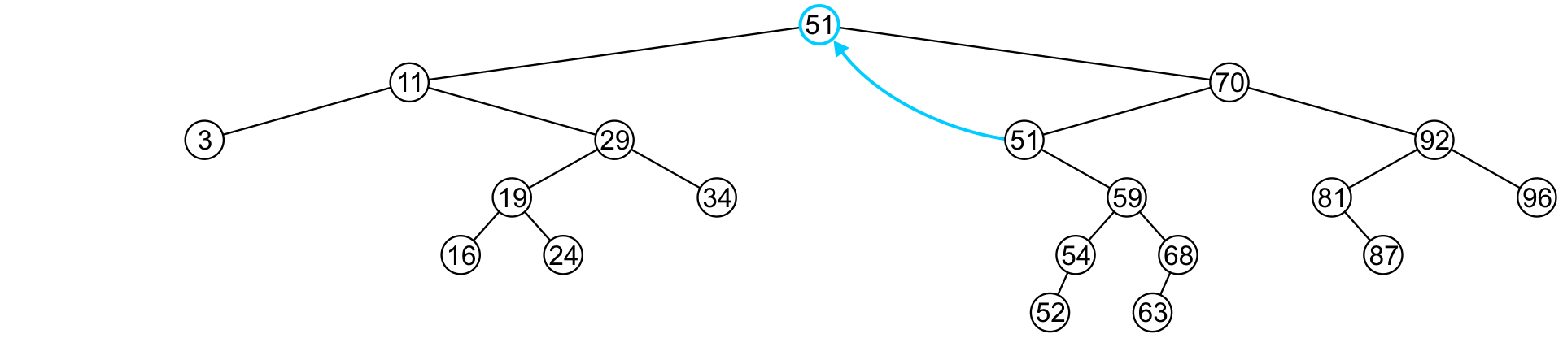
Erase
We copy 51 from the right sub-tree

Slide 55
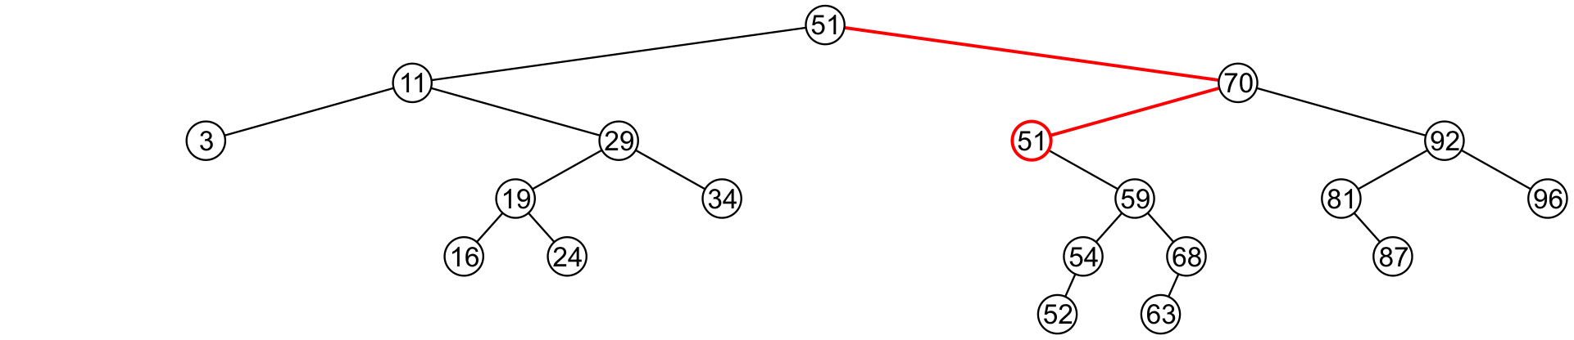
Erase
We must proceed by delete 51 from the right sub-tree

Slide 56
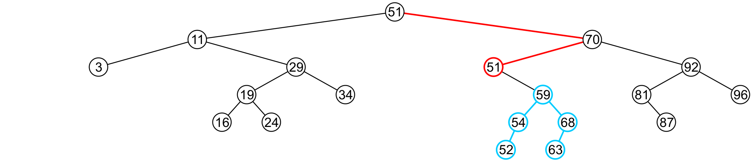
Erase
In this case, the node storing 51 has just a single child

Slide 57
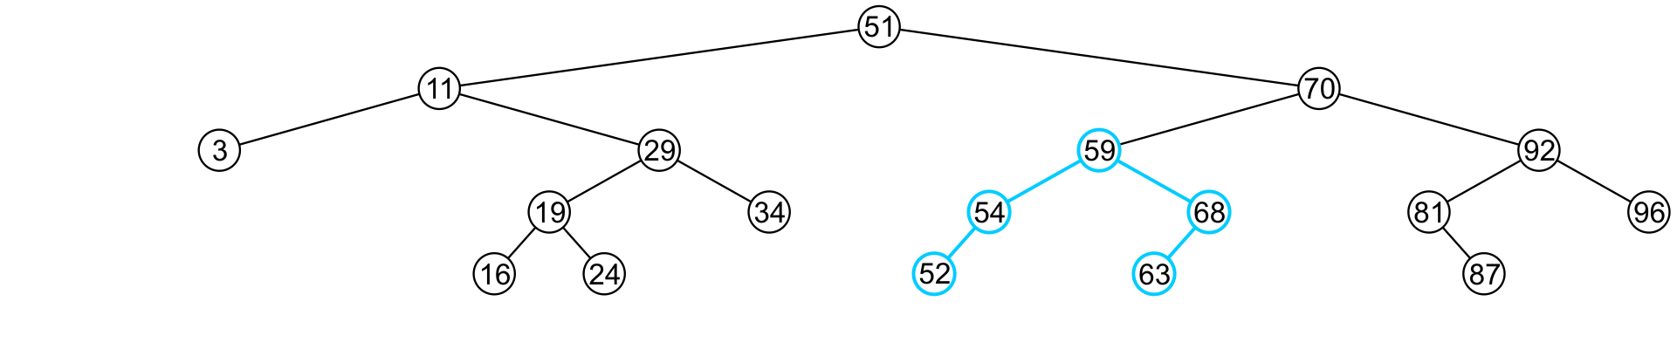
Erase
We delete the node containing 51 and assign the member variable left_tree of 70 to point to 59

Slide 58
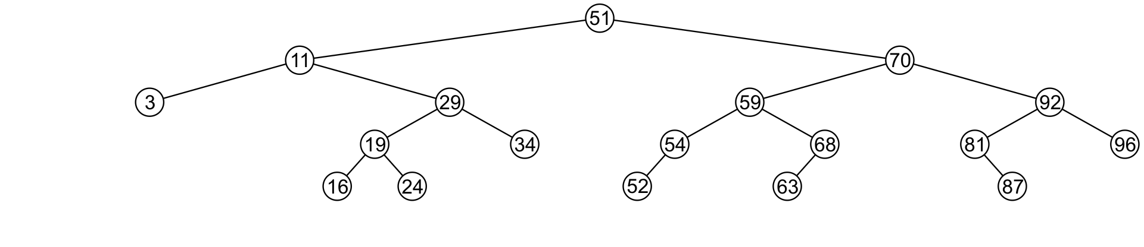
Erase
Note that after seven removals, the remaining tree is still correctly sorted

Slide 59


Erase
In the two examples of removing a full node, we promoted:
A node with no children
A node with right child
What about a node with two children?
It is impossible for the node to have two children

Slide 60
Erase
Recall that we promoted the minimum element in the right sub-tree
If that node had a left sub-tree, that sub-tree would contain a smaller value

Slide 61
Erase
In order to properly remove a node, we will have to change the member variable pointing to the node
To do this, we will pass that member variable by reference
Additionally: We will return 1 if the object is removed and 0 if the object was not found

Slide 62
Erase
template <typename Type>
bool Binary_search_node<Type>::erase( Type const &obj, Binary_search_node *& ptr_to_this ) {
if ( empty() ) {
return false;
} else if ( obj == retrieve() ) {
if ( is_leaf() ) { // leaf node
ptr_to_this = nullptr;
delete this;
} else if ( !left()->empty() && !right()->empty() ) { // full node
element = right()->front();
right()->erase( retrieve(), right_tree );
} else { // only one child
ptr_to_this = ( !left()->empty() ) ? left() : right();
delete this;
}
return true;
} else if ( obj < retrieve() ) {
return left()->erase( obj, left_tree ); } else {
return right()->erase( obj, right_tree ); }
}

Slide 63
Erase
Blackboard example:
In the binary search tree generated previously:
Erase 47
Erase 21
Erase 45
Erase 31
Erase 36

Slide 64
Binary Search Tree
We have defined binary search nodes
Similar to the Single_node in Project 1
We must now introduce a container which stores the root
A Binary_search_tree class
Most operations will be simply passed to the root node

Slide 65
Implementation
template <typename Type>
class Binary_search_tree {
private:
Binary_search_node<Type> *root_node;
Binary_search_node<Type> *root() const;
public:
Binary_search_tree();
~Binary_search_tree();
bool empty() const;
int size() const;
int height() const;
Type front() const;
Type back() const;
int count( Type const &obj ) const;
void clear();
bool insert( Type const &obj );
bool erase( Type const &obj );
};

Slide 66
Constructor, Destructor, and Clear
template <typename Type>
Binary_search_tree<Type>::Binary_search_tree():
root_node( nullptr ) {
// does nothing
}
template <typename Type>
Binary_search_tree<Type>::~Binary_search_tree() {
clear();
}
template <typename Type>
void Binary_search_tree<Type>::clear() {
root()->clear( root_node );
}

Slide 67
Constructor, Destructor, and Clear
template <typename Type>
Binary_search_tree<Type> *Binary_search_tree<Type>::root() const {
return tree_root;
}
template <typename Type>
bool Binary_search_tree<Type>::empty() const {
return root()->empty();
}
template <typename Type>
int Binary_search_tree<Type>::size() const {
return root()->size();
}

Slide 68
Empty, Size, Height and Count
template <typename Type>
int Binary_search_tree<Type>::height() const {
return root()->height();
}
template <typename Type>
bool Binary_search_tree<Type>::find( Type const &obj ) const {
return root()->find( obj );
}

Slide 69
Front and Back
// If root() is nullptr, 'front' will throw an underflow exception
template <typename Type>
Type Binary_search_tree<Type>::front() const {
return root()->front();
}
// If root() is nullptr, 'back' will throw an underflow exception
template <typename Type>
Type Binary_search_tree<Type>::back() const {
return root()->back();
}

Slide 70
Insert and Erase
template <typename Type>
bool Binary_search_tree<Type>::insert( Type const &obj ) {
return root()->insert( obj, root_node );
}
template <typename Type>
bool Binary_search_tree<Type>::erase( Type const &obj ) {
return root()->erase( obj, root_node );
}

Slide 71
Other Relation-based Operations
We will quickly consider two other relation-based queries that are very quick to calculate with an array of sorted objects:
Finding the previous and next entries, and
Finding the k^{th} entry

Slide 72
Previous and Next Objects
Operations specific to linearly ordered data include:
Find the next (larger) and previous (smaller) objects of a given object which may or may not be in the sorted list
Find the k^{th} entry of the sorted list
Iterate through those objects that fall on an interval [a, b]
We will focus on finding the next (larger) object
The others will follow

Slide 73
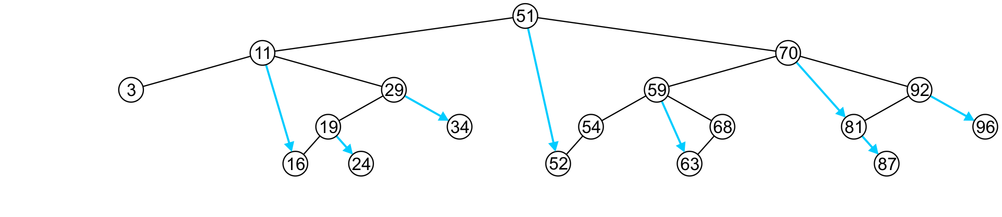
Previous and Next Objects
To find the next object:
If the node has a right sub-tree, the minimum object in that sub-tree is the next object

Slide 74
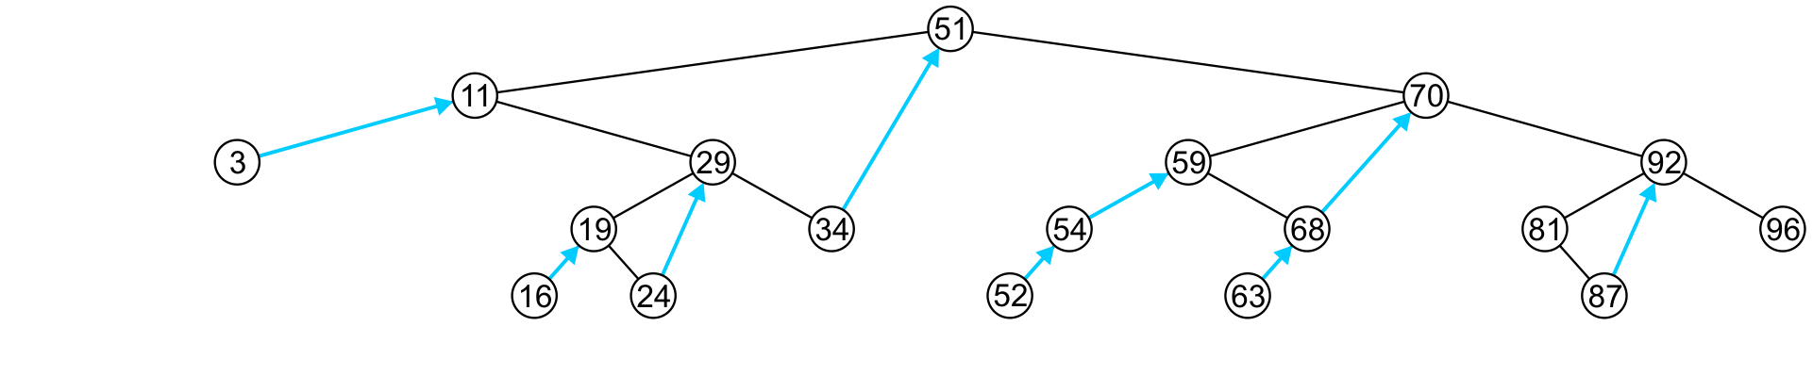
Previous and Next Objects
If, however, there is no right sub-tree:
It is the first larger object (if any) that exists in the path from the node to the root

Slide 75
Previous and Next Objects
More generally: find the next entry of an arbitrary object
Design a function that
runs a single search from the root node to one of the leaves—an O(h) operation
returns the input object if it did not find something greater than it
Ex: 0 → 3; 25 → 29; 40 → 51; 100 → 100

Slide 76
Previous and Next Objects
It returns the next object within this subtree.
Calling it from the root node return the next object in the BST.
template <typename Type>
Type Binary_search_node<Type>::next( Type const &obj ) const {
if ( retrieve() == obj ) {
return ( right() == nullptr ) ? obj : right()->front();
} else if ( retrieve() > obj ) {
if( left() == nullptr )
return retrieve();
else {
Type tmp = left()->next( obj );
return ( tmp == obj ) ? retrieve() : tmp;
}
} else {
return ( right() == nullptr ) ? obj : right()->next( obj ) ;
}
}

Slide 77
Finding the k^{th} Object
Another operation on sorted lists may be finding the k^{th} largest object
Recall that k goes from 0 to n – 1
If the left-sub-tree has ℓ = k entries, return the current node,
If the left sub-tree has ℓ > k entries, return the k^{th} entry of the left sub-tree,
Otherwise, the left sub-tree has ℓ < k entries, so return the (k – ℓ – 1)^{th} entry of the right sub-tree
18
7
10
1
5
0
1
2
3
4
5
6
7
8
9
10
11
12
13
14
15
16
17

Slide 78
Finding the k^{th} Object
template <typename Type>
Type Binary_search_tree<Type>::at( int k ) const {
return ( k < 0 || k >= size() ) ? nullptr : root()->at( k );
// Need to go from 0, ..., n - 1
}
template <typename Type>
Type Binary_search_node<Type>::at( int k ) const {
if ( left()->size() == k ) {
return retrieve();
} else if ( left()->size() > k ) {
return left()->at( k );
} else {
return right()->at( k - left()->size() – 1 );
}
}
(Here I do not check for nullptr for simplicity)

Slide 79
Finding the k^{th} Object
This requires that size() returns in Θ(1) time
We must have a member variable
int tree_size;
which stores the number of descendants of this node
This requires Θ(n) additional memory

Slide 80
Finding the k^{th} Object
We must now update insert(…) and erase(…) to update it
template <typename Type>
bool Binary_search_node<Type>::insert( Type const &obj,
Binary_search_node *&ptr_to_this ) {
if ( empty() ) {
ptr_to_this = new Binary_search_node<Type>( obj );
return true;
} else if ( obj < retrieve() ) {
return left()->insert( obj, left_tree ) ? ++tree_size : false;
} else if ( obj > retrieve() ) {
return right()->insert( obj, right_tree ) ? ++tree_size : false;
} else {
return false;
}
}
Clever trick: in C and C++, any non-zero value is interpreted as true

Slide 81
Summary
Abstract Sorted Lists
Problems using arrays and linked lists
Binary search tree
Definition
Implementation of:
Front, back, insert, erase
Previous smaller and next larger objects
Finding the k^{th} Object

Slide 82
Run Time on BST
Almost all of the relevant operations on a binary search tree are O(h)
If the tree is close to a linked list, the run times is O(n)
Insert 1, 2, 3, 4, 5, 6, 7, ..., n into a empty binary search tree
The best we can do is if the tree is perfect: O(ln(n))
Our goal will be to find tree structures where we can maintain a height of Θ(ln(n))
Solution
AVL trees
Red-black trees
B trees, B+ trees
Splay trees
More…
All of which ensure that the height remains Θ(ln(n))

